Slide 1


Minor Project
Title: Mood Therapy Using Music
Presented by:
R2142201545 - Saksham Rattan
R2142201549 - Siddharth Singh
R2122001529 - Tushar Kalra
R2142201440 - Veer Singh Ryait
Mentored By
Dr. Sanjeev Kumar

Slide 2
Content
Introduction
Literature Review
Objectives
Methodology
Working Model
Results
Conclusion
References
.

Slide 3
Introduction
Music is an ever-evolving industry that provides individuals with an outlet to express their emotions through sounds that incorporate rhythm, melody, and more.
Popular music services, such as Spotify, Wynk, Apple Music, and YouTube, have incorporated recommendation algorithms that suggest relevant music to their users. However, the method of music recommendation might undergo a change in the upcoming years.
Emotion recognition can be captured through different mechanisms such as speech, facial expression, body gesture, etc. According psychologists, communication happening through facial expressions account for about 55% of communication.
Facial detection algorithms are widely used for emotion detection, as they can analyse facial expressions and identify emotions based on them. Music therapy is a well-known technique for mental health treatment.
Our research is based on previous studies that have shown the effectiveness of music therapy in improving mental health outcomes for individuals. Our solution builds upon this research by providing personalised song recommendations that are tailored to the individual's emotional state, which can be used to alleviate negative emotions and promote positive emotions.

Slide 4
Technical Concepts (Algorithms) used
We propose to use stationary wavelet entropy (SWE) as a feature extraction layer of our model. The term "wavelet" describes the wave that a function produces over a distance.
SWE is based on the idea of decomposing the signal into multiple frequency bands using the wavelet transform, which allows for the identification of different patterns or structures within the signal.
Particle Swarm Optimization (PSO) is a popular optimization technique used in artificial intelligence, machine learning, and other fields to find the optimal solution to a problem
The objective function to be optimized is evaluated for each particle, and the best particle, known as the global best, and the best particle in its neighborhood, known as the local best, are updated based on the evaluation.

Slide 5
Motivation
Emotion detection is a topic of interest in the field of artificial intelligence due to its many potential applications. Facial detection algorithms are widely used for emotion detection, as they can analyse facial expressions and identify emotions based on them. Music therapy is a well-known technique for mental health treatment, and recent research suggests that personalised song recommendations can be effective for promoting positive emotions and reducing negative emotions.
Problem Statement
The field of mental health has long sought effective, personalized methods for managing emotional well-being. Facial detection algorithms and music therapy have been individually studied for this purpose, but there is a lack of research on the combined approach. Therefore, the problem we aim to address in this report is to develop a solution for mood therapy using facial detection and personalised music recommendations to promote emotional well-being.
Area of application
In mental healthcare, our solution can be used as a complementary treatment method to alleviate negative emotions and promote positive emotions. In marketing, our solution can be used to personalise advertisements and promotions based on the individual's emotional state. In entertainment, our solution can be used to create personalised playlists for individuals based on their emotional state.

Slide 6
Dataset and input format
The model is trained using a publicly available EMOTIC dataset of natural images, capturing the subjects and their contexts with their natural unconstrained environments to classify new instances into one of the 26 defined emotional categories
The trained model is then integrated with a music recommendation system to identify the most suitable music for the end-user based on their current emotional state. This task is carried out through custom static playlists for each possible emotion from the given categories.

Slide 7

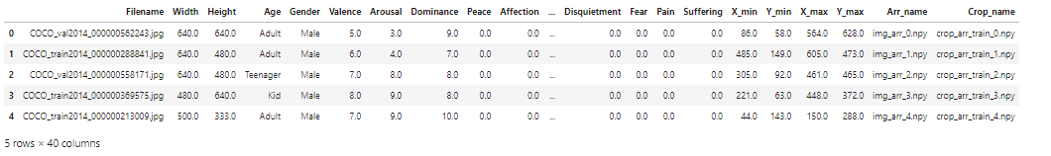
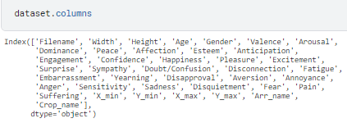

Description of the dataset

Slide 8
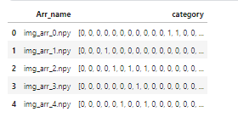
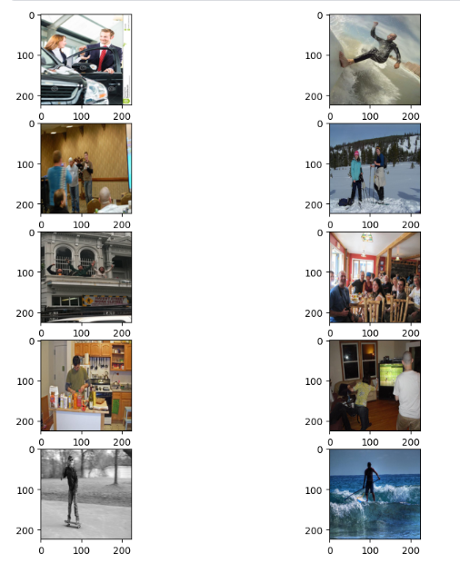
Dataset after processing
Training images examples

Slide 9
Literature Review
Inference from Literature
Emotion recognition has been broadly studied by the Computer Vision community. Most of the existing work has focused on the analysis of facial expression to predict emotions [1],[2]. The base of these methods is the Facial Action Coding System [3] which encodes the facial expression using a set of specific localised movements of the face, called Action Units. These facial-based approaches [1],[2] usually use facial-geometry based features or appearance features to describe the face.
Instead of recognizing emotion categories, some recent works on facial expression [4] use the continuous dimensions of the VAD Emotional State Model [5] to represent emotions. The VAD model describes emotions using 3 numerical dimensions: Valence (V), that measures how positive or pleasant an emotion is, ranging from negative to positive; Arousal (A), that measures the agitation level of the person, ranging from non-active / in calm to agitated /ready to act; and Dominance (D) that measures the control level of the situation by the person, ranging from submissive/ non-control to dominant / in-control.

Slide 10
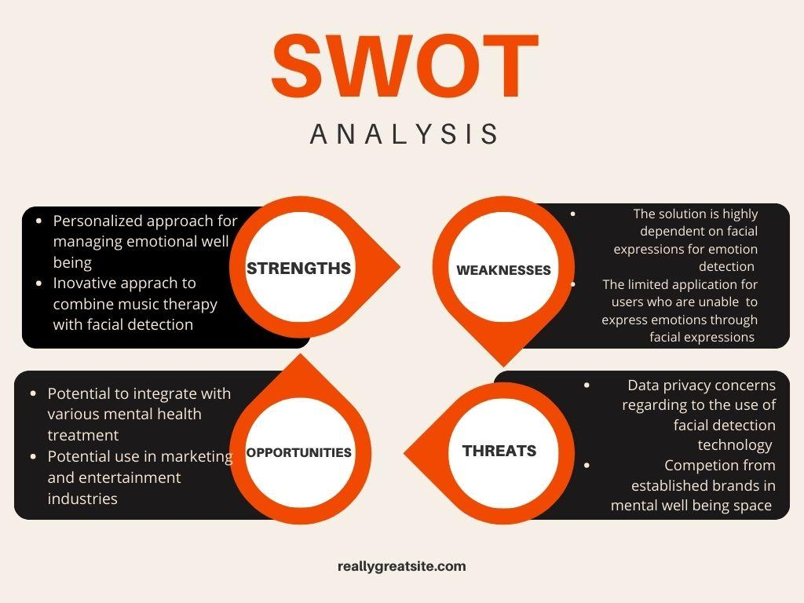


Slide 11
Objective
Main Objective
Develop a machine learning model to detect emotions from facial expressions using the publicly available EMOTIC dataset.
Use the model to predict the emotional state of an individual from their facial expression and extract relevant features.
Recommend relevant music to the user based on their current mood.
Sub Objective
Evaluate the accuracy and reliability of the model in predicting emotional states.
Explore the potential applications of the model for personalised marketing and mental health therapy.

Slide 12
Methodology
We propose to use stationary wavelet entropy (SWE) as a feature extraction layer of our model
This model is trained on the EMOTIC dataset using the discrete emotion categories and without the context of the environment as seen in the traditional approaches to emotion detection.
The trained model is then integrated with a music recommendation system to identify the most suitable music for the end-user based on their current emotional state. This task is carried out through custom API calls to a music provider's API, such as Spotify.
To ensure accuracy and reliability, the model's performance is evaluated, and the shortcomings are addressed. The proposed solution is designed to provide an effective and personalised approach for managing emotional well-being.

Slide 13
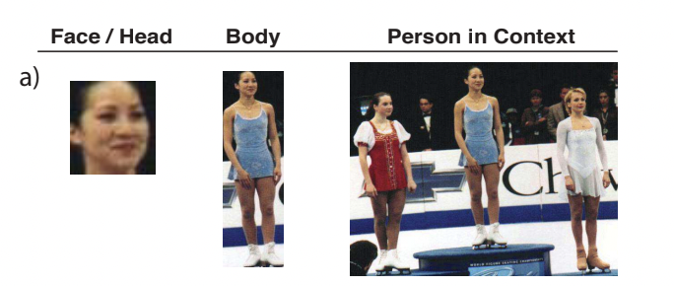
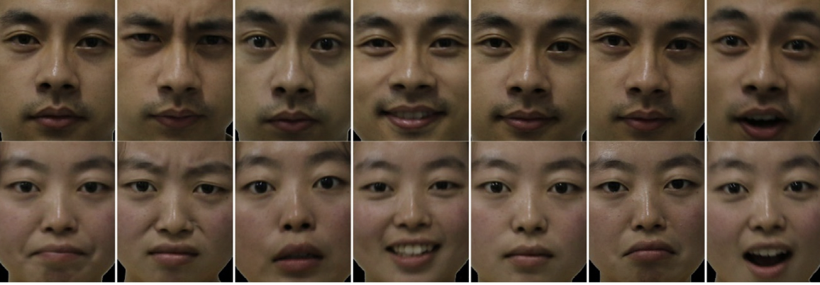
How Stationary Wavelet Entropy is being used ?

Slide 14
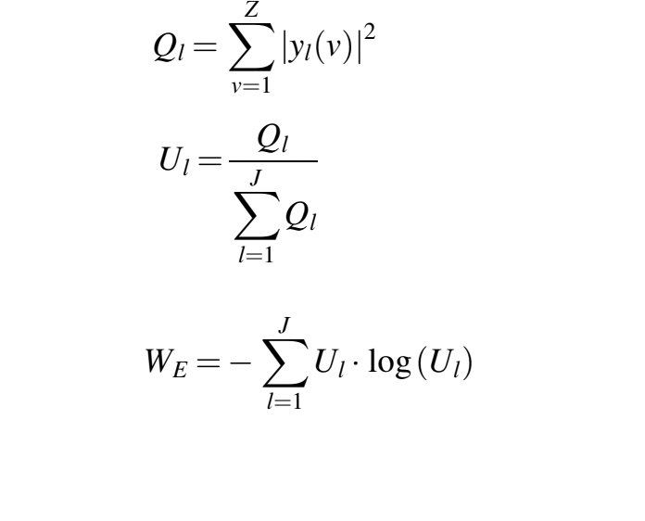
SWE Formula

Slide 15
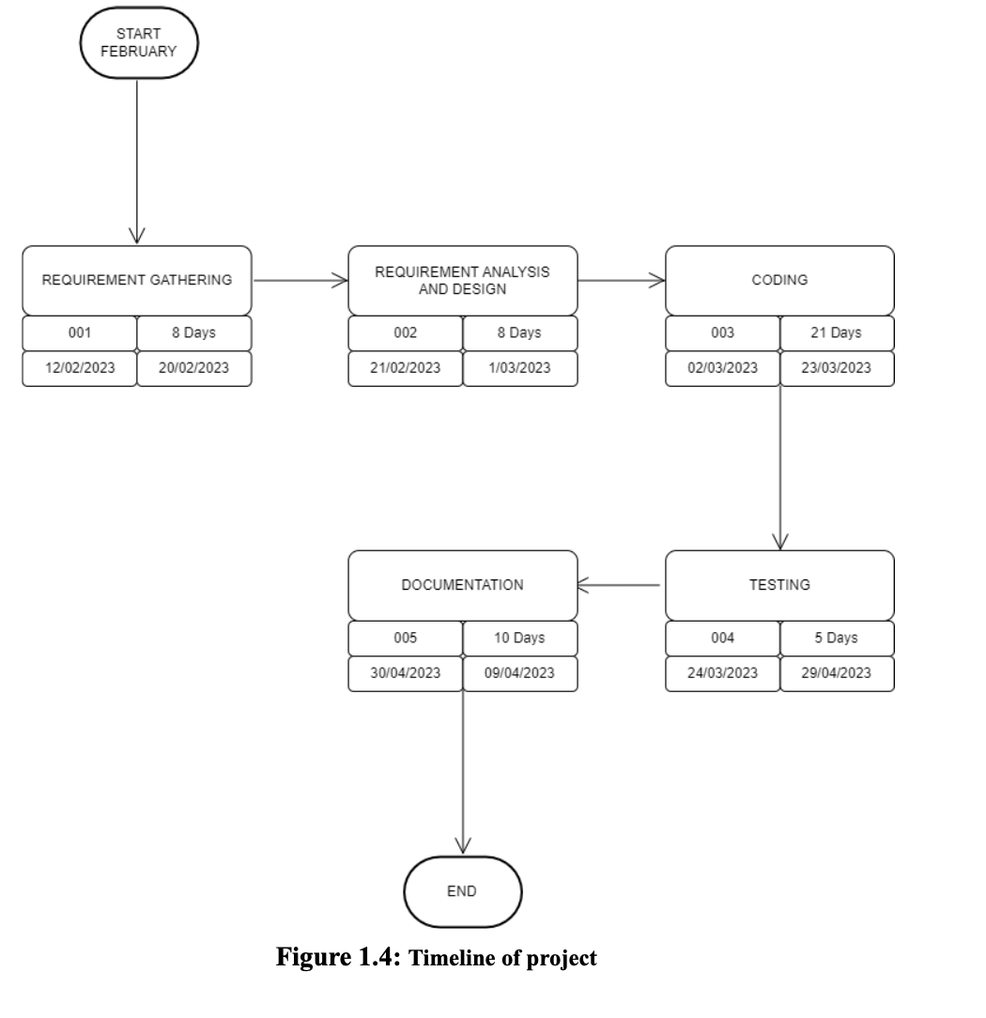

Slide 16
Working Model
Requirement analysis (Link of SRS)
SRS
Reference Algorithm
Facial emotion recognition via stationary wavelet entropy and particle swarm optimization , which is a widely accepted approach for emotions detection in humans. This model is trained on the EMOTIC dataset using the discrete emotion categories and without the context of the environment as seen in the traditional approaches to emotion detection. This model along with its metrics is studied and compared to our proposed model. Our proposed model is based on the approach given by Xiang Li and Junding Sun [7]. We propose to use stationary wavelet entropy (SWE) as a feature extraction layer of our model.

Slide 17
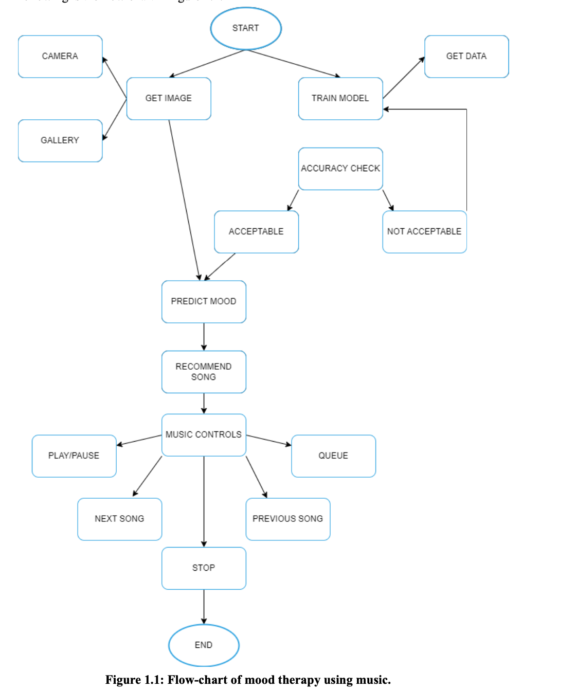
Technical Diagram

Slide 18
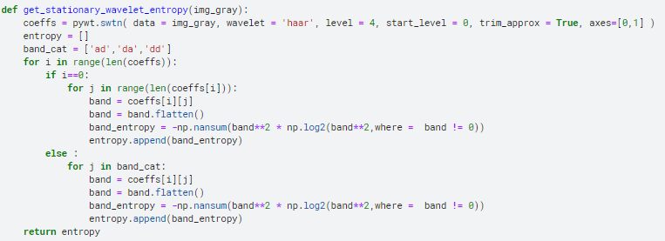
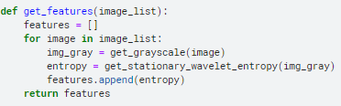
Working Model:
Stationary Wavelet Entropy

Slide 19
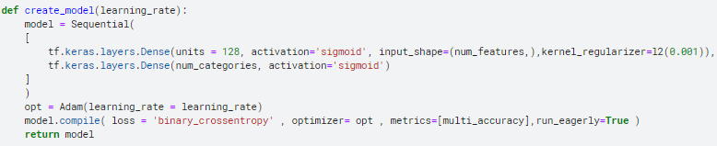
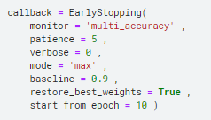
Neural Network

Slide 20
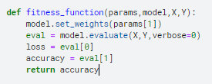
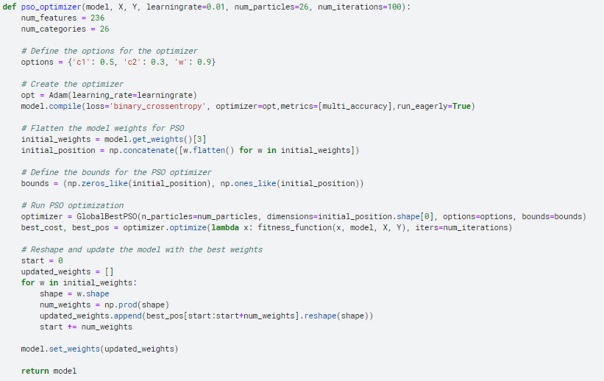
PSO

Slide 21
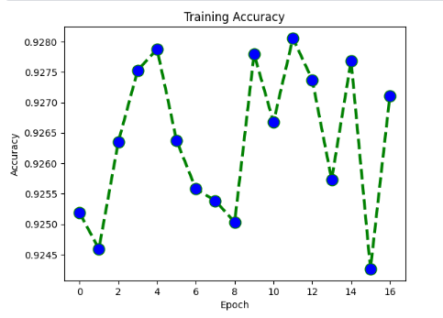
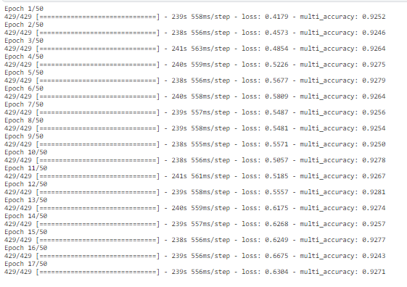
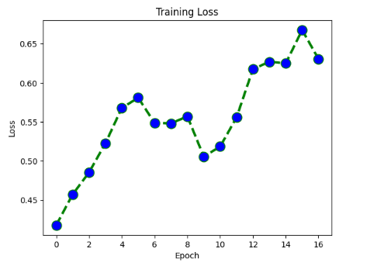
Results

Slide 22
Conclusion
In several disciplines, including psychology, marketing, and human-computer interaction, the development of emotion recognition systems has showed considerable promise. These systems are capable of correctly identifying emotions from facial expressions, voice, and physiological signs, which can offer important clues about a person's emotional state. There are still several issues that must be resolved, such as ensuring the precision and dependability of these systems in practical contexts, dealing with privacy issues, and resolving technological constraints.
Overall, emotion recognition systems have great potential benefits, and with more research and development, these systems may have a substantial influence on a variety of fields and applications.

Slide 23
Reference
List of cited papers
[1] A. Mehrabian, "Communication without words", Psychol. Today, (1986).
[2] U. Soderstrom and H. Li. Emotion recognition and estimation from tracked lip features.
[3] M. S. Bartlett, G. Littlewort, I. Fasel and J. R. Movellan, Real Time Face Detection and Facial Expres- sion
Recognition: Development and Applications to Human Computer Interaction, 2003 Conference on Computer
Vision and Pattern Recognition Workshop, Madison, Wisconsin, USA( 2003). 53-53. 10.1007/BF02884429.
[4] A. Krizhevsky, I. Sutskever, and G. E. Hinton, “Imagenet classification with deep convolutional neural
networks,” in Advances in neural information processing systems, 2012, pp. 1097–1105.
[5] B. Zhou, A. Khosla, A. Lapedriza, A. Torralba, and A. Oliva, “Places: An image database for deep scene
understanding,” CoRR, vol. abs/1610.02055, 2015.
[6] A. Thakallapelli, S. Ghosh and S. Kamalasadan, "Real-time frequency based reduced order modeling of large
power grid," Power and Energy Society General Meeting, 2016, Boston, MA, USA.
[7] Xiang Li and Junding Sun, “Facial emotion recognition via stationary wavelet entropy and particle swarm optimization”, College of Computer Science and Technology, Henan Polytechnic University, Jiaozuo, People’s Republic of China.

Slide 24
Thank You

